Slide 1
YOLO v3
Object Detection and Tracking using YOLO v3 Framework for Increased Resolution Video
Paper Link: https://l.facebook.com/l.php?u=http%3A%2F%2Fwww.ijitee.org%2Fwp-content%2Fuploads%2Fpapers%2Fv9i6%2FE3038039520.pdf%3Ffbclid%3DIwAR0QKTcThoa7l9xEFWCpKLZbXAPLwpDuoS8vGw9hMcGmB95zjTAvu_odpR8&h=AT2xO2NEP6voHKM6PV2rGA83mFP5AGeWQXhK1y2tcqDYZYJ1Eg0ijnjeW1qN1iQzcVAdsDEOrEuLIVrjRycu1ZE0E03pDL4XELj_LeXSGMigReMSwSm1XFcBaEsevDSlxjPUcw

Slide 2
Introduction
The proposed system is used for vehicle detection and tracking from the high-resolution video.
It detects the object (vehicles) and recognizes the object comparing its features with the features of the objects stored in the database.
If the features match, then object is tracked.

Slide 3
YOLO v3
YOLOv3 is the latest variant of a popular object detection algorithm YOLO – You Only Look Once. The published model recognizes 80 different objects in images and videos, but most importantly it is super fast and nearly as accurate as Single Shot MultiBox (SSD).
A new vehicle detection model YOLO V3 with Keras, Numpy, and Tensor flow, OpenCV for image processing and displaying the results is proposed to solve the problems of existing vehicle detection, such as lack of vehicle type identification, poor detection accuracy and slow speed.

Slide 4
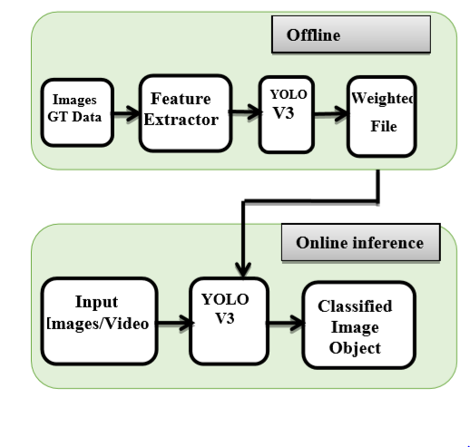
Implementation
Offline:
The data in the form of images is given to the feature extractor in offline processing and then these extracted features are applied for training to the YOLO v3 system. It creates the YOLO v3 model weight files.
Online:
In the online process, the output does not know what video or image is on the input side and what the image or video is exactly. The video input is applied to the pre-trained model YOLO v3. The weight file output and the video input are the two data for the pre-trained model YOLO v3.
Fig.1. Object Detection and Tracking Proposed

Slide 5
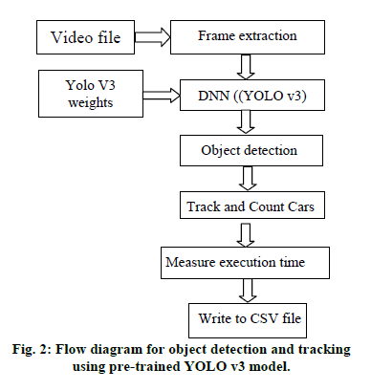
ALGORITHM
FLOWCHART
Step I: The input video file is given to the module.
Step II: Frames are extracted from the videos.
Step III: Extracted frames are given to the Deep Neural Network.
Step IV: Yolo V3 weight file is also given to the Deep Neural Network (YOLO v3).
Step V: Object (car) is detected here with the help of the YOLO v3 module.
Step VI: Cars are counted hereafter the object is detected.
Step VII: It measures the execution time for the frame per second. Step VIII: Write to the CSV file.

Slide 6
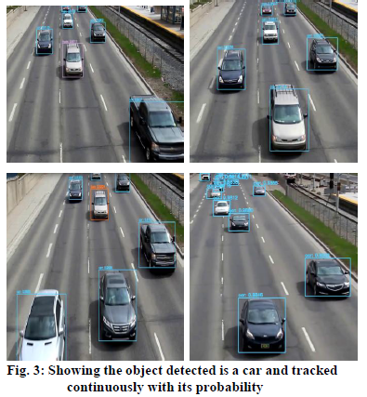
RESULTS AND DISCUSSION
YOLO is special, as it looks at a certain part of an object only once, like other classifiers. As an object detector, this technique is much quicker with comparable precision. OpenCV is used to display the Results.
We could detect a car in the frame using Yolo v3 and measure the accuracy using the confusion matrix.
The various probabilities indicate that the detected object is a car with a probability of 0.82, 0-1 indicates the likelihood of being a car.
Figure 3 shows the object detected is car and tracked continuously with its probability.

Slide 7

Accuracy and Comparison
Table: Assessment of Suggested Method With Recent Techniques Concerning Accuracy
Fig: Comparison of Proposed Method with Recent Method Concerning MAP (%)

Slide 8
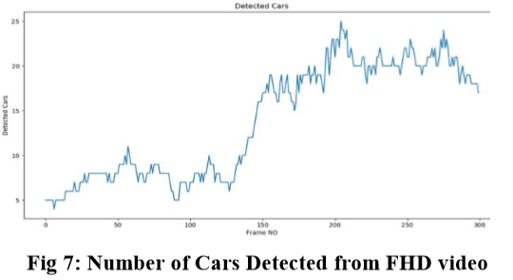
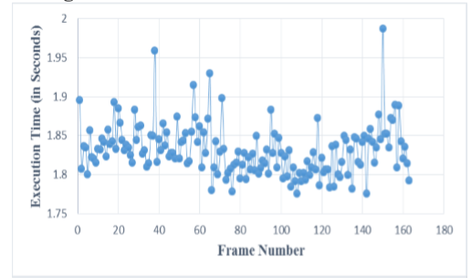
Detection level
Fig 3: Number of Cars Detected from FHD vide
Fig 6: Execution time for FHD video

Slide 9
CONCLUSION AND FUTURE WORK
The proposed system is used for vehicle detection and tracking from the high-resolution video.
The system uses the pre-trained YOLO v3 framework to detect and track the object with Keras, Numpy, Tensor flow, and OpenCV.
For object detection and tracking, there are two phases offline and online processing, The pre-trained template YOLO v3 is trained with some vehicle images and is tested using the dataset PASCAL VOC.
To detect and monitor the object in video, real-time video is applied to the pre-trained YOLO v3 model in the offline step.
It identifies the object and identifies the object by comparing its features to the features of the objects stored in the database.
The limitation of the proposed detection of moving objects is that it cannot be used in real-time applications.
Further development of a proposed system to detect with improved speed and accuracy will be the future scope.

Slide 10
REFERENCES
Xun. Li, Yao. Liu, Zhengfan. Zhao, Y. Zhang, and L. He, “A Deep Learning Approach of Vehicle Multitarget Detection from Traffic Video,” Journal of Advanced Transportation, vol. 2018, pp. 1–11, Nov. 2018.
Shuoyuan. Xu, A. Savvaris, S. He, H. Shin, and Antonios Tsourdos, “Real-time Implementation of YOLO+JPDA for Small Scale UAV Multiple Object Tracking,” 2018 International Conference on Unmanned Aircraft Systems (ICUAS), Jun. 2018.
Rachel Huang, J. Pedoeem, and Cuixian. Chen, “YOLO-LITE: A Real-Time Object Detection Algorithm Optimized for Non-Graphical Processing Unit Computers,” 2018 IEEE International Conference on Big Data (Big Data), Dec. 2018.

Slide 11


